Slide 1
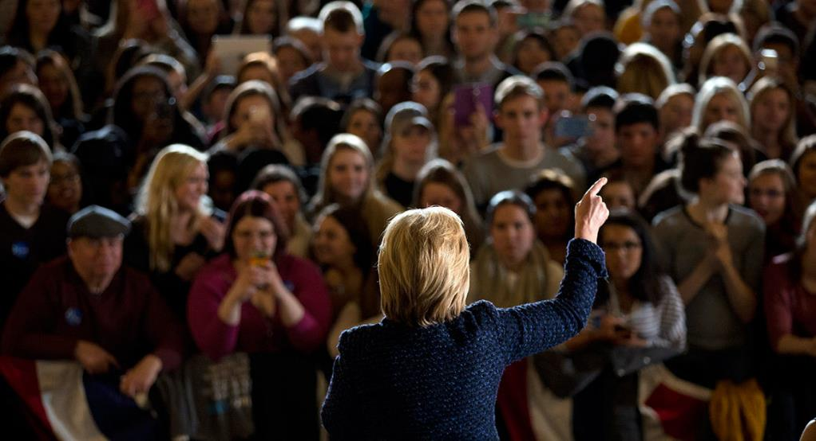

November 19, 2016
Year of the Woman or More of the Same?
The Status of Women in American Politics after Election 2016
Kelly Dittmar, Ph.D.
@kdittmar
@CAWP_RU

Slide 2
Election 2016 results
115th Congress: 104 (78D, 26R)
  Senate: 21 (16D, 5R) (+1 from 114th Congress)
    19% of women members, 4% of all members will be women of color
  House: 83 (62D, 21R) (-1 from 114th Congress)
    40% of women members, 7.6% of all members will be women of color
  14 (12D, 2R) non-incumbent women won seats, including 9 (D) women of color
    1st Latina woman senator
    1st South Asian women in Congress
    1st woman member from Delaware
Governors in 2017: 5 (2D, 3R) (-1 from 2016)
Statewide Elected Executive Offices: 74 or 75 (of 312) (vs. 75 current)
State Legislatures: Preliminary numbers show likely increase, but not historic.

Slide 3
Women in Congress: 1971-2016

Slide 4
Women Governors
6 women serve as governors in 2016
History:
  37 women (22D, 15R) have served as governors in 27 states
Party:
  3 Democrats
  3 Republicans
Race/Ethnicity:
  2 women of color
  First women (2) of color governors elected in 2010

Slide 5
Women in State Legislatures
1,805 women serve in state legislatures in 2016 (24.3%)
Chamber:
  22.5% of state senators
  25.2% of state representatives
Party:
  60% Democrats
  39% Republicans
  0.2% Independents
  0.6% Nonpartisan
Race/Ethnicity:
  22.1% of women legislators are women of color
  5.4% of all members are women of color

Slide 6
Women in State Legislatures: 1971-2016
Percentage of Women

Slide 7
Women in U.S. Politics
2016
19.4%
24%
24.6%
Congress
Statewide Elected Executive
State Legislatures
2017
24.3% -
24.9%
19.4%
24%
Congress
Statewide Elected Executive
State Legislatures

Slide 8
Women in State Legislative Elections: 1971-2016

Slide 9
- Jackson Katz
“Presidential politics are the site of an ongoing cultural struggle over the meaning of American manhood.”
Leading Men: Presidential Campaigns and the Politics of Manhood

Slide 10
- Hillary Clinton
“I’m not asking people to vote for me simply because I’m a woman. I’m asking people to vote for me on the merits. I think one of the merits is I am a woman.”
2015

Slide 11
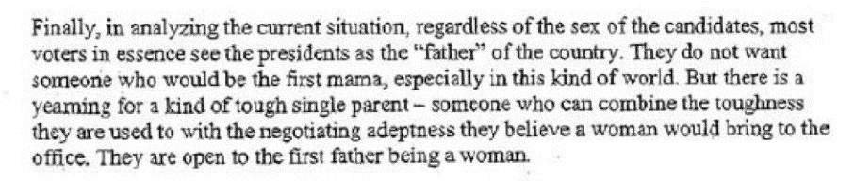
Penn’s “Launch Strategy” Memo
Hillary Clinton for President
December 21, 2006

Slide 12
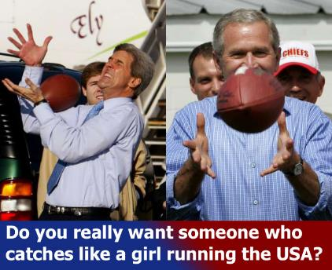
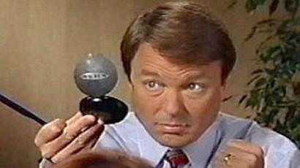
Authentic Masculinity/Emasculation

Slide 13
Authentic Masculinity/Emasculation

Slide 14
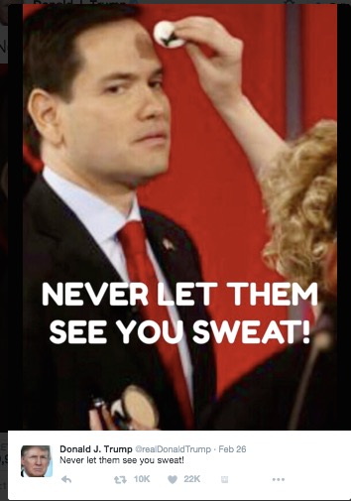
Authentic Masculinity/Emasculation

Slide 15
“Dangerous”

Slide 16
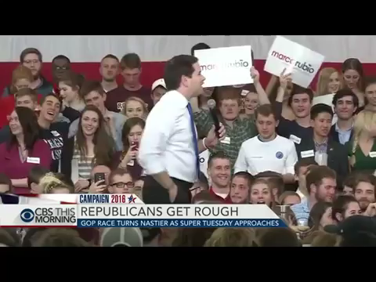
“You know what they say about small hands…”

Slide 17
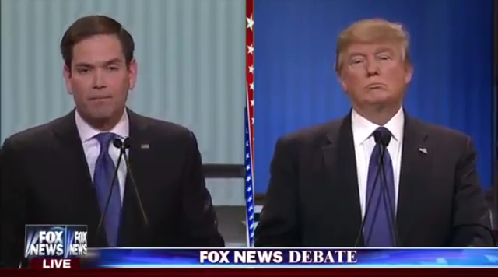
“I guarantee you there is no problem.”

Slide 18
Emasculating Male Candidates

Slide 19
- Hillary Clinton,
Democratic National Convention
Emasculating Male Candidates
“A man you can bait with a tweet is not a man we can trust with nuclear weapons. I can't put it any better than Jackie Kennedy did after the Cuban Missile Crisis. She said that what worried President Kennedy during that very dangerous time was that a war might be started – not by big men with self-control and restraint, but by little men – the ones moved by fear and pride.”
July 2016

Slide 20
“Dangerous”
Masculinist Protection
October 2016

Slide 21
Voter Perceptions of a Woman President
Question:
Would you vote for a qualified woman for president?

Slide 22
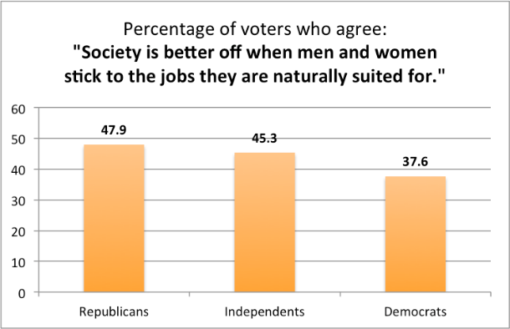
Voter Perceptions of a Woman President
Source: Public Religion Research Institute

Slide 23
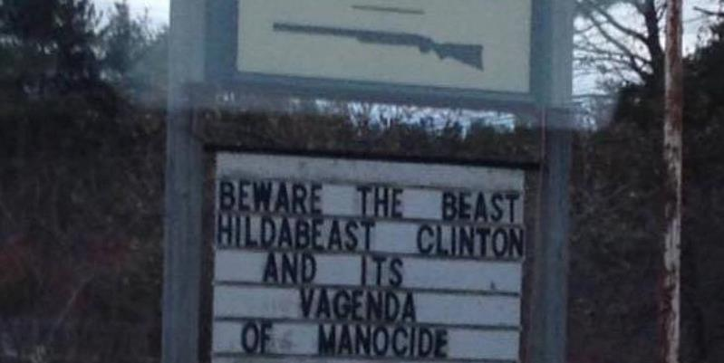
Precarious Manhood

Slide 24
Voter Perceptions of Gender

Slide 25
Voter Perceptions of Gender

Slide 26
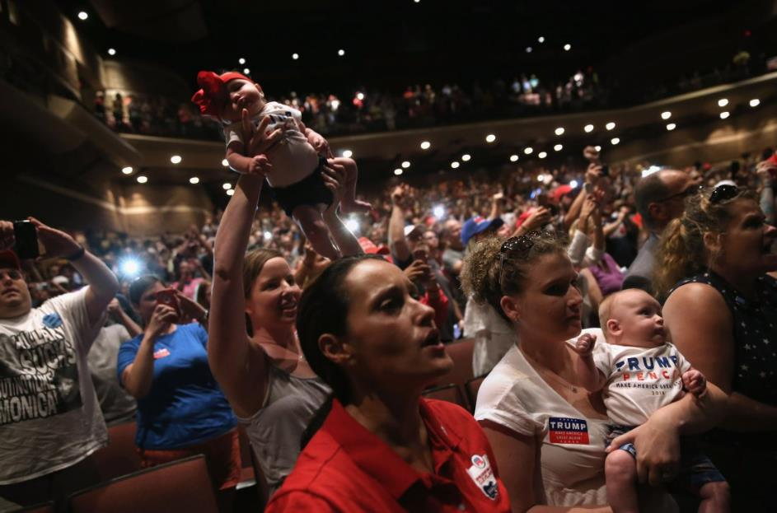
For more information:
kdittmar.rutgers.edu
presidentialgenderwatch.org
cawp.rutgers.edu
@kdittmar
@CAWP_RU

