Slide 1
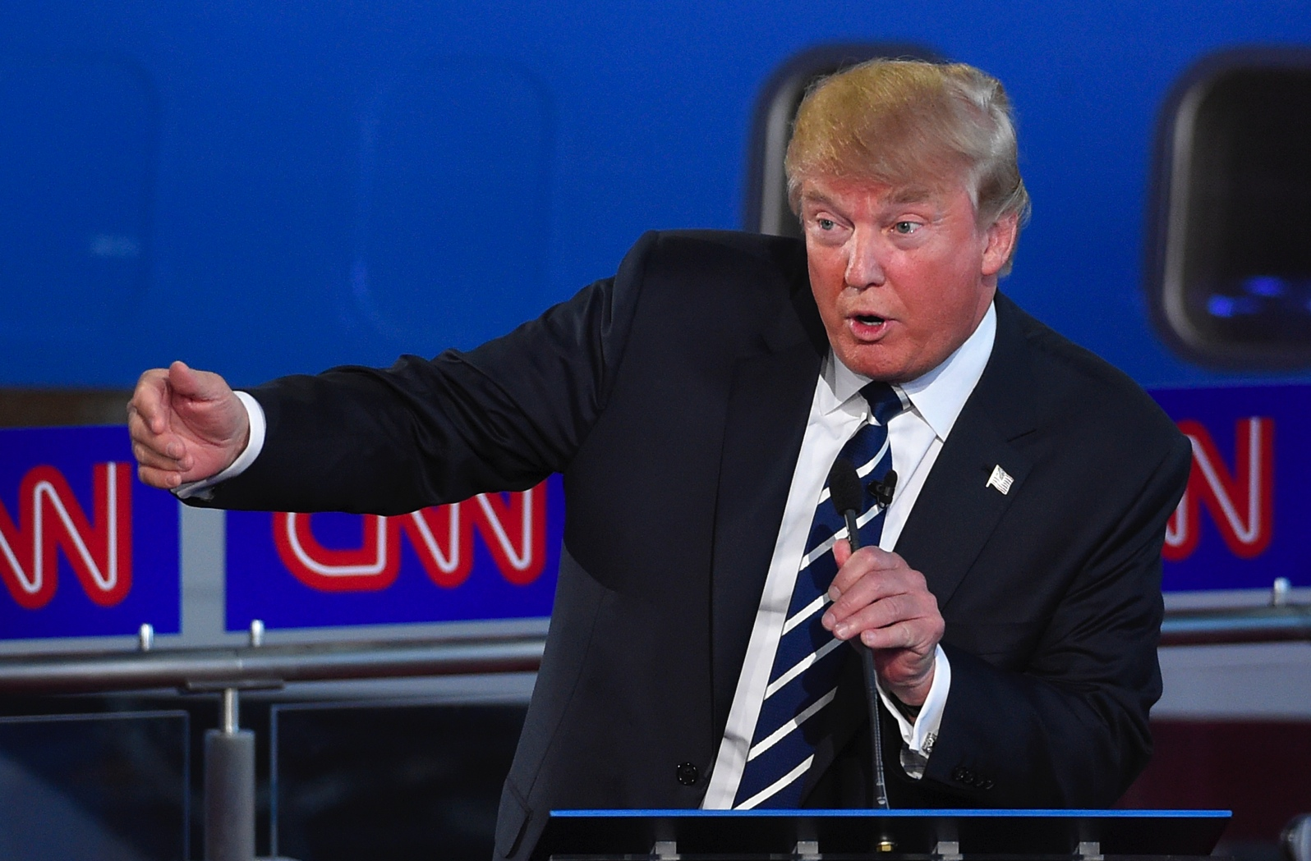
The Opposite Election
Reflections in primary colors

Slide 2
America’s Brexit?

Slide 3
Tradition dictates …
Successful presidential candidates:
Have public service or military experience
Express moderate views
Have well-organized campaigns
Obtain key media endorsements
Have consistent positions & statements
Don’t attack the news media
Are endorsed by their own party’s leaders
Act “presidential,” stay on message
Are hard targets for character attacks

Slide 4
A reversal
Donald Trump defied tradition and won in the opposite way.
The media’s role in the election was overtaken by other forces.

Slide 5
On this night, it worked

Slide 6
A primal scream?
62 percent of America believed Hillary Clinton has the better temperament, and 61 percent believed she is more qualified.– Fox Business News.
But neither of those things mattered in the end.
“This was a primal scream by an angry people who wanted change.” – David Axelrod, CNN.
“This was a rebellion against the elites; it was a ‘whitelash’ against a changing country.” – Van Jones, former Obama advisor.

Slide 7
A jolt for everyone
Polls – and journalists – were blindsided.

Slide 8
Why?
Who voted and who didn’t
The election turnout
A silent slice of America
Clues were there
The irony of political correctness

Slide 9
True beliefs hidden?
Societal pressures at work

Slide 10
The keys for Trump
He’s the ultimate outsider
His “Wall” (literally and metaphorically)
Jobs/Trade Agreements
ISIS Threat
Gun rights advocacy
Clinton’s Emails
Benghazi

Slide 11
Campaign 2016 was great news

Slide 12
Full of news value
Conflict/Drama
Uniqueness
Human Interest
Timeliness
Impact
Proximity
Celebrity
Competition
Entertainment value
These were how the media judged the hopefuls as candidates for news coverage. Not necessarily in this order..

Slide 13
The media
A caveat about that word media.

Slide 14
The (usual) media effect
“All I know is what I read in the newspapers.” – Will Rogers, American humorist.
“[There is] the world outside, and the pictures in our heads.” – Walter Lippmann, American journalist and philosopher.
“We no longer search for the news; the news finds us.” – Erik Qualman,author of Socialnomics, 2009.

Slide 15
2016: the effect is blunted
Other forces challenge the media’s influence in this election.

Slide 17
A probe too late?
No serious, steady journalistic probing or questioning of Donald Trump came until he had already built solid momentum in the primary races.
More on this later.

Slide 18
How the season began
The 2016 presidential election season began, in earnest, in August, 2015.
It was an overcrowded field.

Slide 19
17 Republicans start

Slide 20
…and 5 Democrats

Slide 21
7 questions faced media
How to allot limited air time to each candidate in a fair and logical way?
On what basis do you grant equivalency to the candidates? Is each as legitimate as the next?
Do facts matter to all voters? (If not, how much time to spend fact-checking?)
What role does media economics play in the coverage of these candidates?
How does the social media factor in?]
How do you reach those who get their views from fake news?
What does this election say about America?

Slide 22
Question 1
Air Time

Slide 23
7 never had a chance

Slide 24
The right way to do it?

Slide 25
How to grant time fairly?
The polls?
Candidate’s resume’ or vita
Should candidates earn their time on air?
Should candidates be sanctioned for making untrue statements?
Should candidates automatically be given equal time and be sanctioned if they use more?

Slide 26
Air time winners

Slide 27
Question 2
Equivalency

Slide 28
2 kinds of equivalency
Are the candidates themselves equally qualified to be president?
Are the critiques of the candidates equal?

Slide 29
A vexing problem
Treating all hopefuls as equally legitimate contenders, or risk being accused of bias.

Slide 31
Question 3
Do facts matter?

Slide 32
What were the motivators?

Slide 33
2016: Year of the fact checker
In journalism circles, 2016 is the year of the fact-checker.
“Trump made fact-checking great again.” …CNN Money.

Slide 34
Many voters seek facts
Monthly unique visitors to the Washington Post Fact Checker blogs this year were five times higher than in 2012.
Other fact-checking destinations have reported big upticks in traffic too.
PolitiFact’s file on Trump has had 2.7 million page views so far this year.
"Fact-checking is now a proven ratings getter," Brooks Jackson said.
CNN often fact-checked Trump in real time on the screen. One graphical banner in August said ”Trump calls Obama founder of ISIS (He’s not).”

Slide 35
Accuracy over balance
The traditional model of "he said, she said" journalism, where news reports simply put both sides of a story against one another, was discarded; a more aggressive journalism arose that ranked accuracy over balance.

Slide 36
Back to the core values
It unburdened the American press from false equivalency and made them more responsible stewards of information.
"This election has made people appreciate the core value of journalism, which is getting to the truth,” said Steven Ginsberg, the Washington Post's senior politics editor.. "Sometimes that means calling something a lie. Sometimes that means saying 'that's not true.'”

Slide 37
Question 4
Media Economics

Slide 38
Election is big TV money
CNN reportedly made an extra $100 million this year mostly because of Donald Trump’s candidacy.

Slide 39
Question 5
Social Media

Slide 40
The Facebook question

Slide 41
Few change their minds
According to a September, 2012, Pew survey, 84 percent of social media site users say they have not changed their mind on a political issue because of their friends’ postings.
But 25 percent consider social networking “somewhat” or “very” important for debating or discussing political views.

Slide 42
… a kind of hush
A spiral of (social media) silence?

Slide 44
But it gets us involved more

Slide 45
What about millennial voters?
A 2015 University of Hawaii study suggests that user-generated comments on social media can influence the reputations of political candidates in the eyes of potential Millennial voters.

Slide 46
Question 6
Fake news

Slide 47
Fake news
A Pew research report has found half of Americans use Facebook as a news source.
So it is troubling that fake news stories have appeared on Facebook through the site’s online advertising service.
Those fake stories have also infiltrated Google and have influenced online searches.
This week both Facebook and Google vowed to prevent those fake stories from appearing on their sites.

Slide 48
About Trump’s Tweets

Slide 49
Why keep the tweets?
For some reason, Trump couldn’t find the delete key and instead kept thousands of his tweets active online.

Slide 50
No new support via Twitter
Trump’s tweets may have kept him connected with members of his voter base who use Twitter, but there is no evidence they advanced his candidacy beyond that base.

Slide 51
Question 7
America reflected?

Slide 52
A profile of America
A divided country
Fear of being left out of the American dream
A growing fear of terrorism
Too much globalism for many
Similar populism that produced Brexit
Too much change, too fast?
Pent-up anger and frustration, caught in an age of political correctness
Anger erupted in private voting booths Nov. 8
A resolve to survive and unify, and a history of doing it.

Slide 53
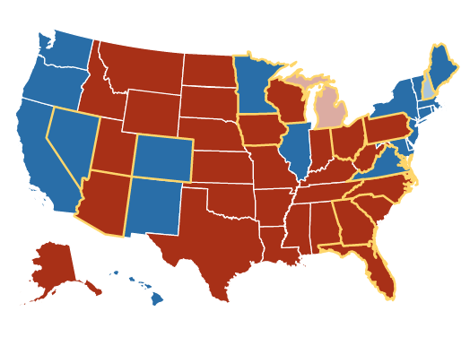
Did the media catch this?
The mood of the country: did journalists get it?

Slide 54
What’s ahead?
Reuniting is the task ahead for America, and its media can help.
But the media’s watchdog function is as vital as ever.

